Slide 1

BBER’s Timber Harvest & Industry
Information & Analysis
Todd Morgan, CF ; Steve Hayes, CF ; Michael Niccolucci
Forest Industry Research Program, Bureau of Business and Economic Research
(BBER)
University of Montana
Forest Land Taxation Advisory Committee
September 9, 2021

Slide 2

Bureau of Business and Economic Research
The University of Montana, Missoula
Research branch within College of Business
Regional economic analysis
Survey research
Industry analysis
  Health care
  Manufacturing
  Energy
  Forest products Industry

Slide 3
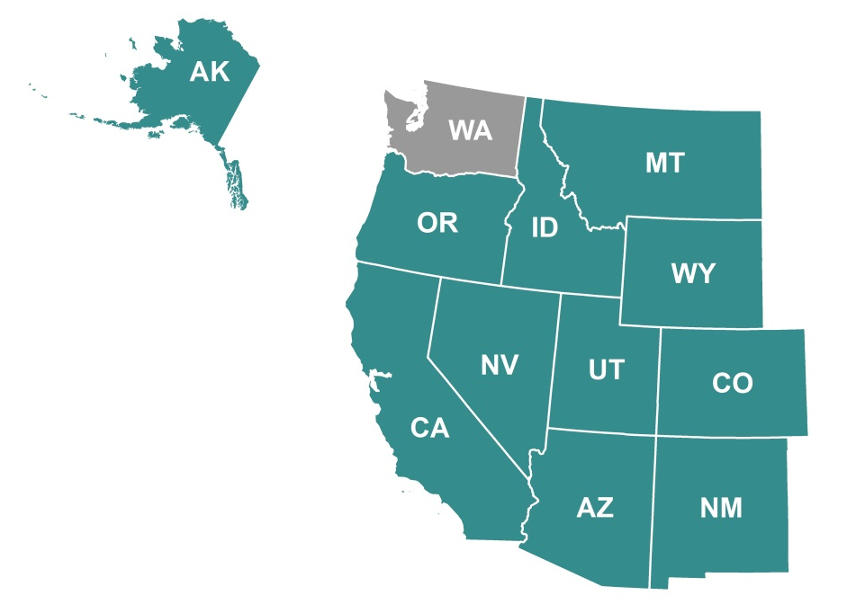

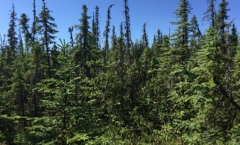
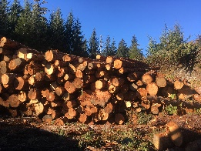
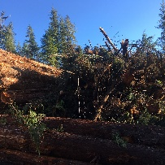
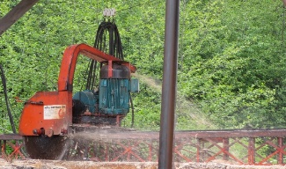
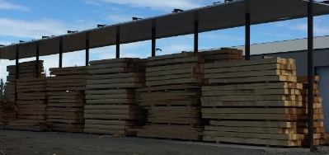
Forest Industry Research Program
Sponsored research – mostly US Forest Service
State level timber harvest & industry analyses
Logging utilization studies
West-wide timber product output (TPO) reporting
Annual & quarterly Montana information
Annual logging & hauling costs for FS Northern Region
Other forest economics & timber related projects
Notes:
The founder of our program, Chuck Keegan, began doing this research in partnership with the Forest Service in the early 1970’s. It began with industry reports in Montana then Idaho and has expanded to include all the western states except Washington. In 2002 Todd Morgan added the logging utilization research. We have branched out into capacity and capability analyses and are currently working on a nationwide timber flow project.

Slide 4
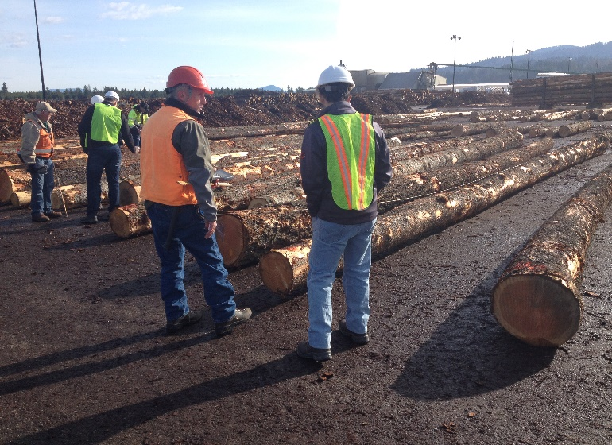
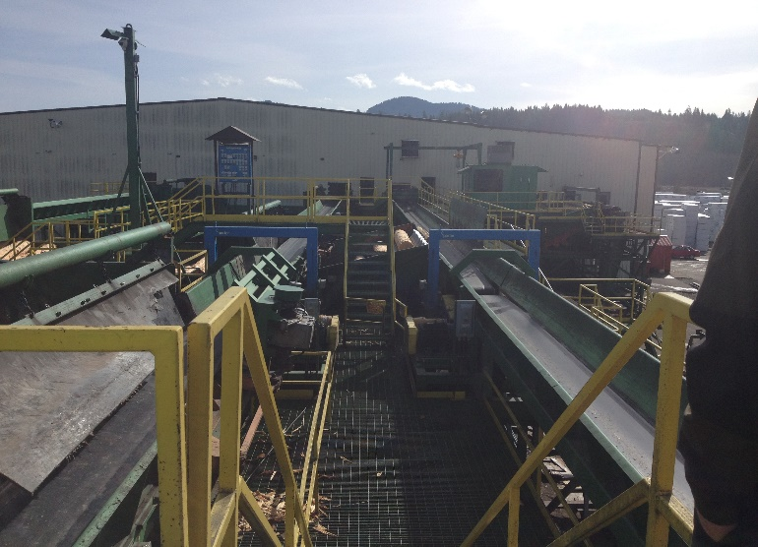
Montana Forest Industry Census
1976, 1981, 1988, 1994, 1998, 2004, 2009, 2014, 2018
Timber harvest & flow volume, species, size, county and ownership, destination & uses.
Mill type, location, capacity, equipment, employment.
Product volume, sales and market locations.
Mill residue volumes of bark & wood fiber uses.
Employment and labor income
Notes:
Users of our information: MLA, MWPA, DNRC & other state agencies, USFS, BLM & other feds, attorneys, others…
We have mill-level information on volume received by ownership, spp, county of harvest; use these data for timber flow/timbershed/market area analyses for USFS & others.

Slide 5
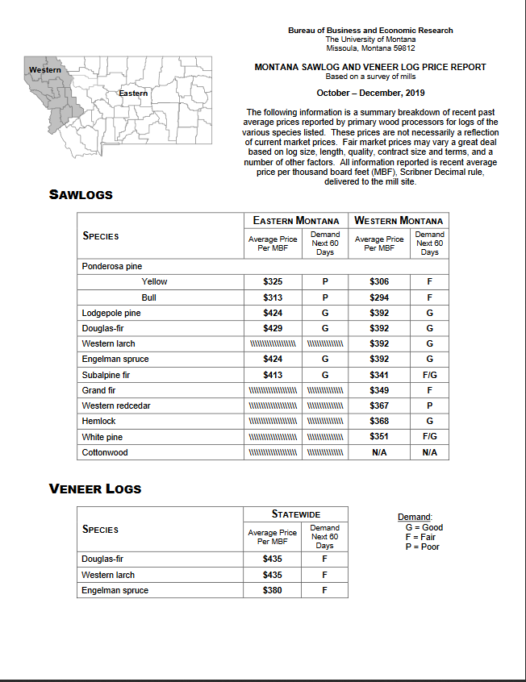

Delivered Log Prices
Quarterly
Since 1985
Montana sawmills accounting for >90% of volume processed
Online at: bber.umt.edu/FIR/F_LogPrice.asp
Notes:
Self-reported by consistent set of MT mills. Was over 20, now about 10-11 mills.
Users of our information: MLA, MWPA, DNRC & other state agencies, USFS, BLM & other feds, attorneys, others…

Slide 6
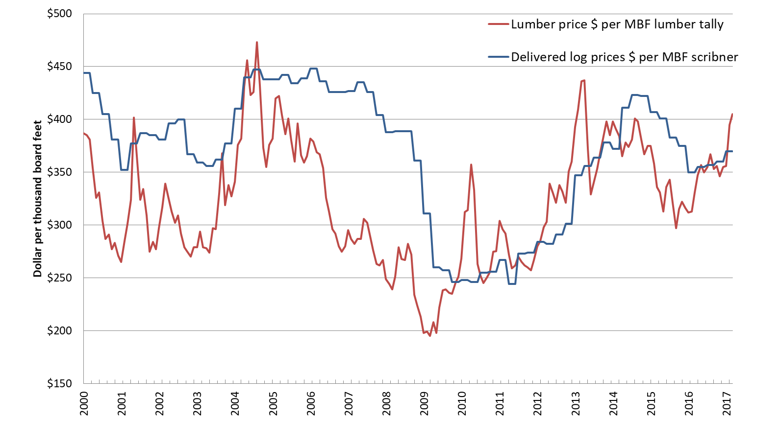

Lumber prices vs. delivered log prices 2000-2017
(Sources: Random Lengths; BBER)
Notes:
Lumber prices (red line) have fallen since 2014. Down more than $60/mbf from 2014 prices.
Right now, an over-supply of lumber in U.S. It may not last as we get into spring/summer building season.
But we had very slow construction & housing starts in 1st Q, strong U.S. dollar and slowing Chinese exports drawing in more Canadian and overseas lumber.
Can see that log prices (blue line) have dropped some from 2014, but not nearly as much as lumber.
First quarter saw log prices have declined about $15/mbf (3.6% on average) from 4Q 2014.
Log prices in MT are about what they were in late 2007/early 08. Still up quite a bit from 2009 & 2010 lows!
Demand for sawlogs is still relatively high in MT. Mills need logs, but prices they can offer is impacted by falling lumber price.

Slide 7
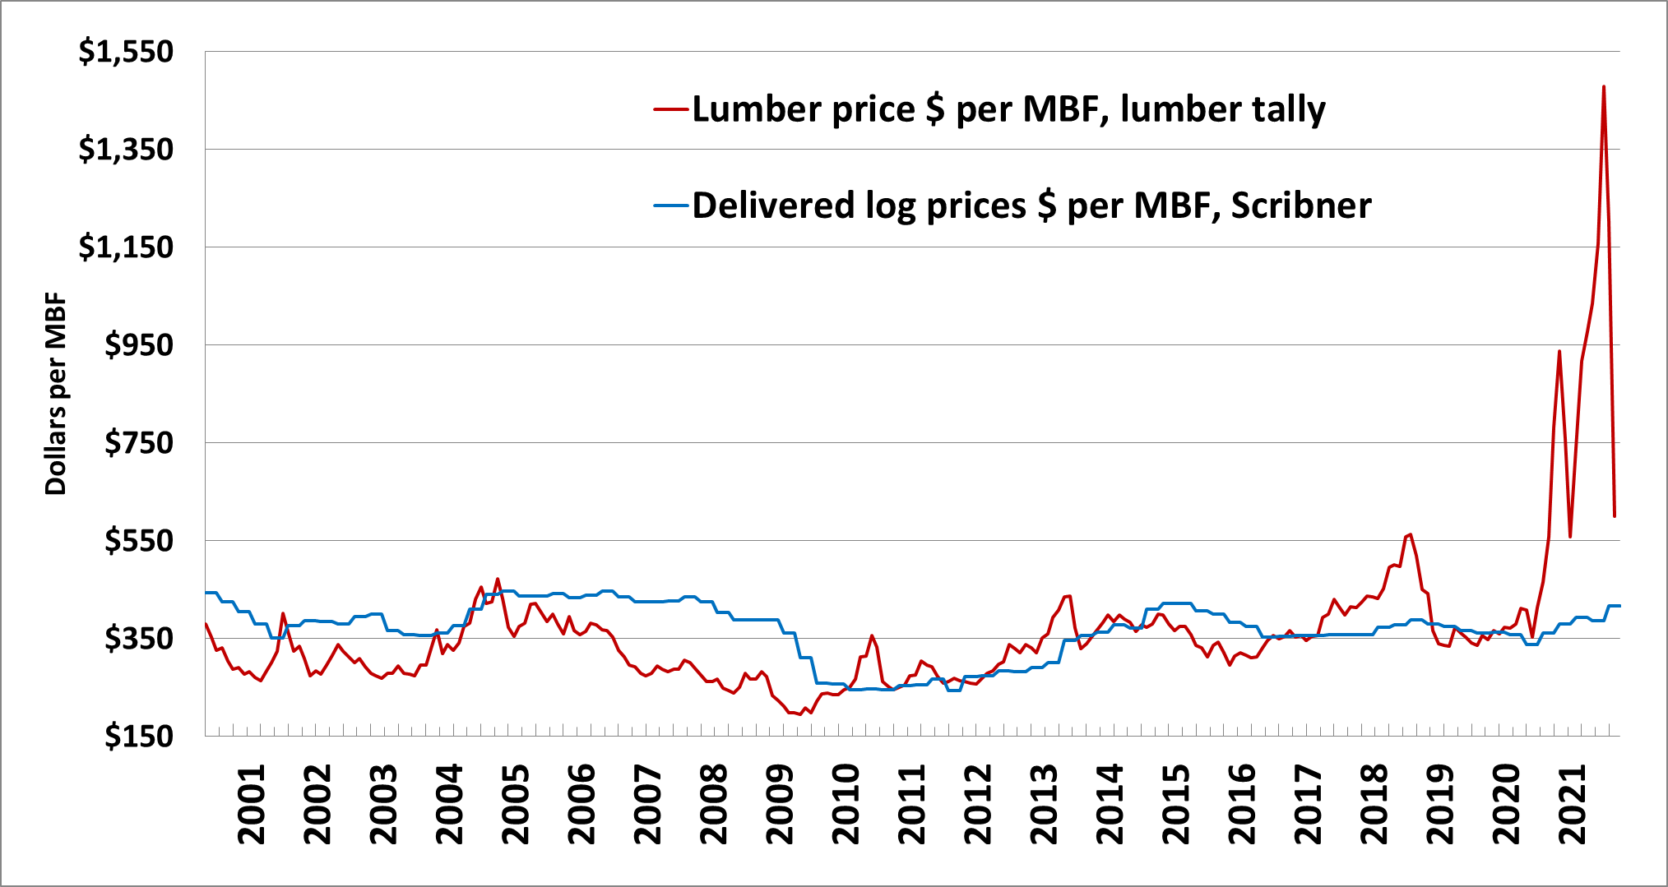
Lumber prices vs. delivered log prices 2000-2021
Source: BBER and Random Lengths
Notes:
This graph shows the Montana average quarterly delivered log prices (blue) against the random length’s western monthly framing lumber composite index (red). The price listed on the graph is in nominal (that) years dollars.
They somewhat move in conjunction with each other but many factors affect the magnitude and length of deviation. The time around the great recession (2005-2010) is one example. The mill price for logs didn’t go down as quick as the lumber market did. Recovery was also slower and log prices still haven’t gotten back to pre-recession levels. Many other factors are in play of course supply, demand, housing starts, Canadian lumber dispute etc.

Slide 8
Forest Service R-1 Timber Appraisal
  Providing Timber Appraisal Equations for estimating fair market value of standing timber since January 2019.
Logging & Hauling Costs
  Providing Logging & Hauling Costs to USDA Forest Service, Region 1 since 2005.
Timber Flow and Market Areas/Appraisal Zones
  Used by USDA Forest Service (nationally) in regional economic analysis of timber industry impacts and to determine appraisal zones in Region 1 since 1991, and Region 4 since 2019.
Transaction Evidence Appraisal Equations
  Peer reviewed in Western Journal of Applied Forestry, Canadian Journal of Forest Research, Appraisal Journal, Forest Industries

Slide 9
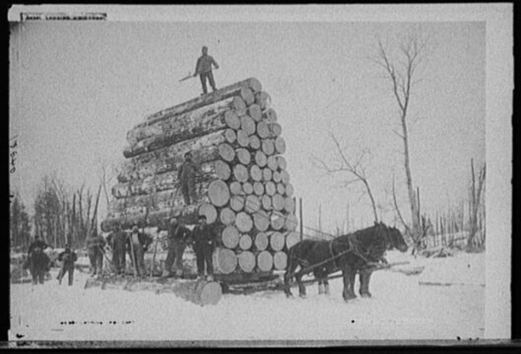
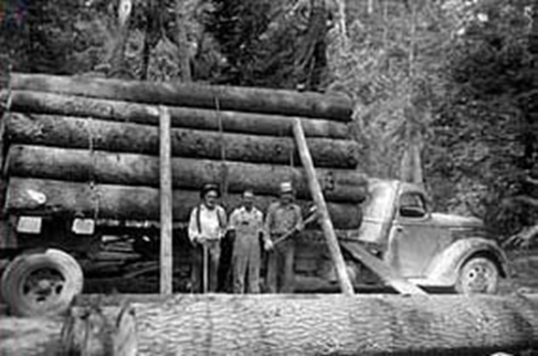
Why Estimate Logging Costs?
To remain aware of impacts of changes and help maintain industry viability, managers and contractors must remain informed of operating costs.
Is the current harvesting capacity adequate to meet future demand?
Industry expressed needs:
  Provide resource for assessing equipment types and entry costs
  Provide equipment cost and price per unit volume data for negotiation tool/baseline guide for bidding or appraisal for extended industry
Notes:
Because consideration of costs is crucial to mitigating the current economic challenges the industry faces

Slide 10
Logging Cost Studies
Machine Costing
Time and Motion Studies
Expert Opinion

Slide 11
BBER Logging Cost Approach
(Harvest Cost Collection Approaches and Associated Equations for Restoration Treatments on National Forests; Keegan et. al, 2002. Forest Products Journal, vol. 52, no. 7/8)
Methods – Statistical Analysis of Expert Opinion Responses
  Regression analysis used to develop logging and haul cost models based on costs collected from experts
  Repeated measure design
    Each respondent considered an observation and each scenario served as the repeated measure
  Very simple models. Tradeoff between survey complexity and development of a parsimonious model (model that accomplishes a desired level of prediction with as few predictor variables as possible).

Slide 12
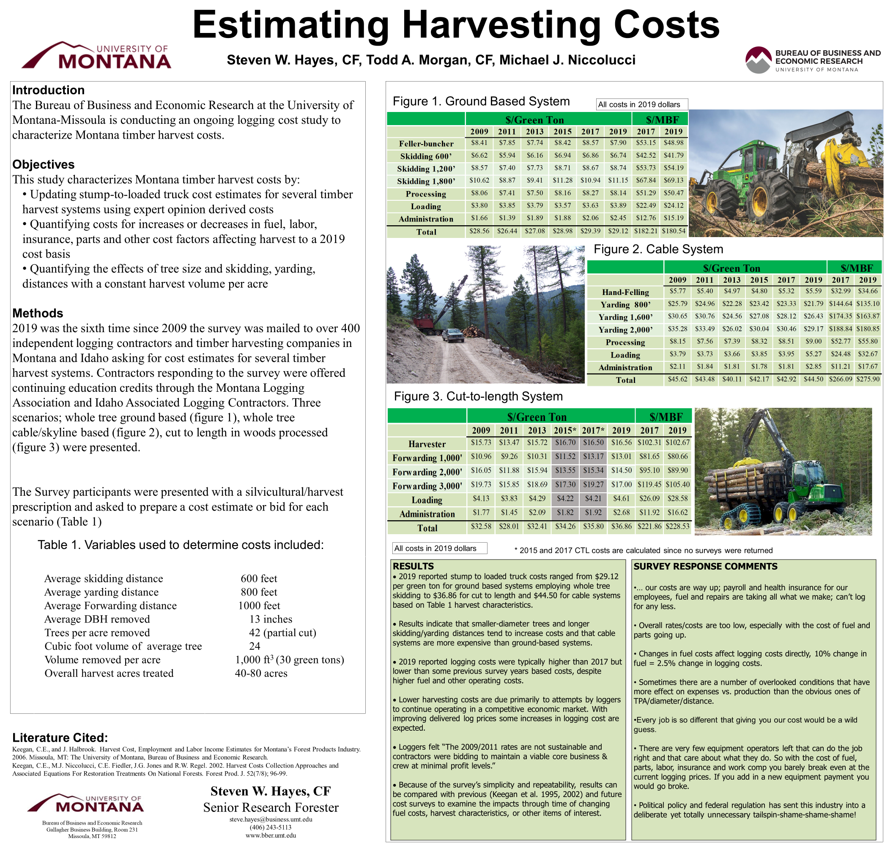
Notes:
Since 2009…

Slide 13
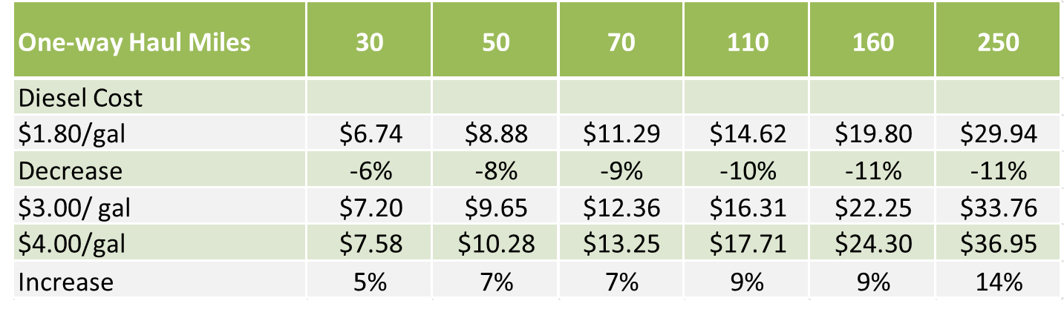
Conventional Truck: cost/delivered ton

Slide 14
Residual Value (RV) Appraisal
 | $ / MBF
REVENUES
Delivered Log Price | $ 419.30
COSTS
Stump to Mill Costs
Stump-to-Loaded Truck Costs | $ 250.60
Haul Costs | $ 47.48
Other Timber Sale Costs
Road Maintenance Costs | $ 10.10
Brush Disposal Costs | $ 25.18
Temporary Development (Roads) Costs | $ -
Specified Road Costs | $ 39.88
Non-sawtimber Adjustment | $ -
Total Private and Forest Service Costs | $ 373.24
ESTIMATED STUMPAGE VALUE (REVENUE - COSTS) | $ 46.06
Minimum Rate or Required Reforestation | $ 24.26
BREAKEVEN POINT | $ 397.50
Example sale:
Kootenai NF
Use of delivered log prices & costs to estimate fair-market value of standing timber

Slide 15
Sample
R-1 Timber Appraisal Equation
Notes:
Sales comparison or Transaction-evidence approach

Slide 16
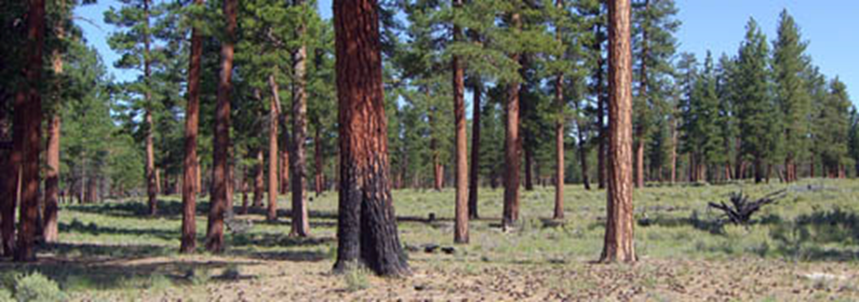
Thank you!
Todd.Morgan@business.umt.edu
Steve.hayes@business.umt.edu
Michaelniccolucci@gmail.com
www.BBER.umt.edu/FIR

